Slide 1
FlatMagic: Improving Flat Colorization through AI-driven Design for Digital Comic Professionals
Chuan Yan¹, John Chung², Kiheon Yoon³,
Yotam Gingold¹, Eytan Adar² & Ray Hong¹ ¹ George Mason University,
² University of Michigan,
³ Pusan National University
https://github.com/Nauhcnay/flat_magic_backend
Notes:
Hi! My name is Chuan Yan and I’ll introduce our work FlatMagic: Improving Flat Colorization through AI-driven Design for Digital Comic Professionals. This work is a collaboration with Yotam Gingold, Ray Hong from George Mason University, John Chung, Eytan Adar from University of Michigan and Kiheon Yoon from Pusan National University.

Slide 2
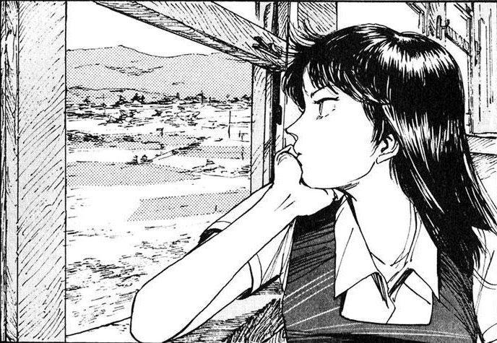
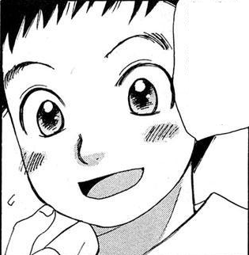
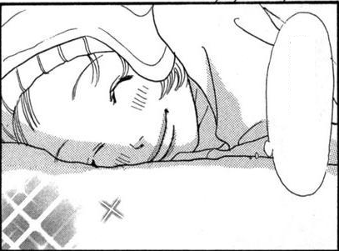
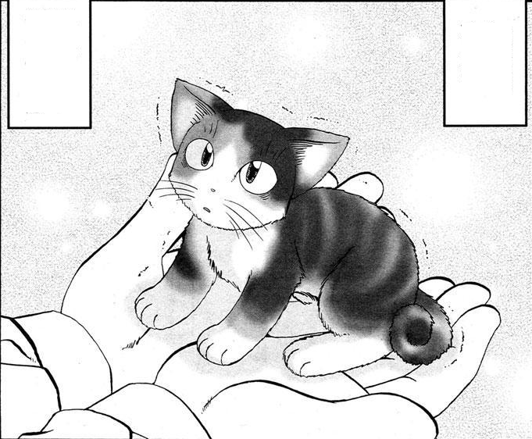
Comic Industry shifting from Paper to Digital
[Image source:
Manga109 Dataset]
[Image source:
Studio Zilpung]
Notes:
The digitized drawing technology has greatly improved the artist’s work efficiency, profoundly changed their standard workflow, and even the entire industry. However, as industry standard has increased, the workload for artists is still enormous
For example, the webcomic has a much higher degree of colorization, therefore, it still takes the same amount of time and effort for the artist to complete compared to traditional paper-based comics.

Slide 3
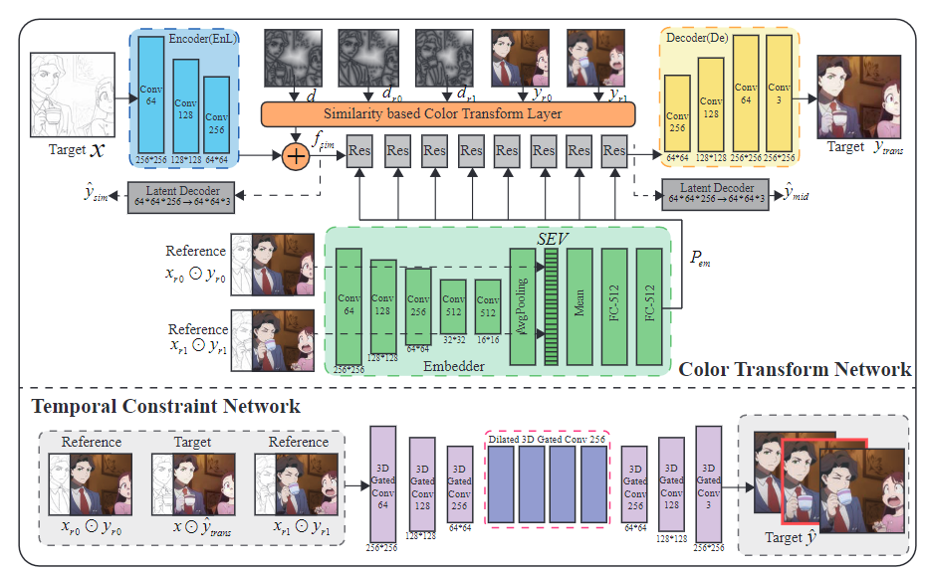
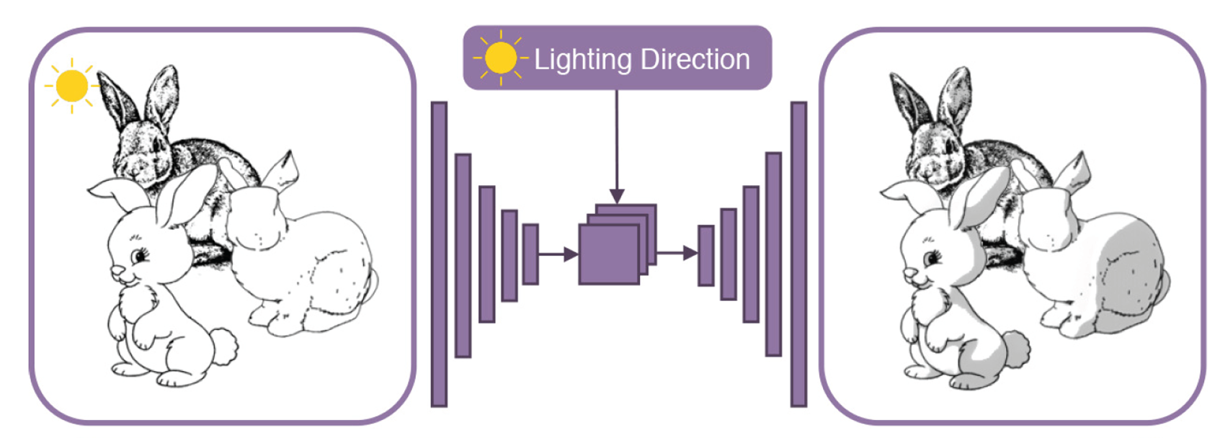
Problems in AI-assistant Drawing
[Qu et al. 2005]
[Zhang et al. 2020]
Furusawa et al. 2017]
[Shi et al. 2020]
[Zhang et al. 2018]
[Zheng et al. 2020]
Notes:
On the other hand, there are also many research works that try to automate the colorization stage and many of them show impressive results. However, few of those technologies have been widely used by professional artists.
https://github.com/qyzdao/Sketch-Based-Deep-Learning
https://github.com/MarkMoHR/Awesome-Sketch-Based-Applications

Slide 4
Formative Study: Interviews about Colorization
5 Professional Cartoon Artists
1 hour each
Understand
Workflow
Challenges
Perception of AI tools
Feature wish list
Factors behind intention to adopt
Notes:
Therefore, to figure out the reason behind this, we seek to understand professionals’ step-by-step colorization workflows and their perception of AI-driven automation.
we interviewed five professionals who have published their work in commercial comic distribution platforms for more than three years.
each interview lasts 1 hour.
We try to collect information from their workflow, challenges in their work, general thoughts and expecting features on AI tools, then find out the key factors that affect them accepting AI automation.

Slide 5
Common Workflow in Comic Colorization
Line Drawing
Flatting
Shading
Lighting
Special Effects
Notes:
The interview result shows there exists a common workflow for all interviewed professionals, which include: Line drawing, Flat colorization, Shading, Lighting, and Special Effects.
Additional analysis identified one special stage in this workflow - Flatting
(click)
This stage shows several characteristics that particularly fit for AI-driven automation. We will discuss the reasoning behind in a few next slides.

Slide 6
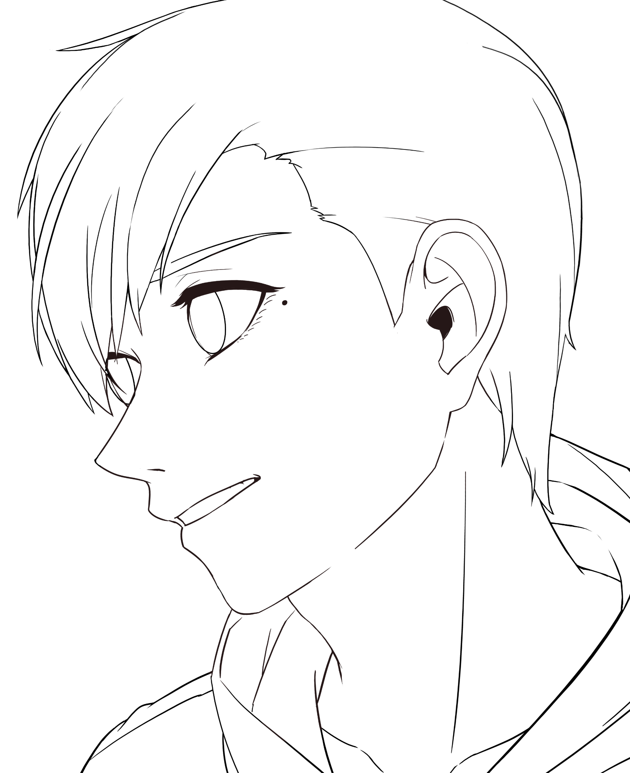
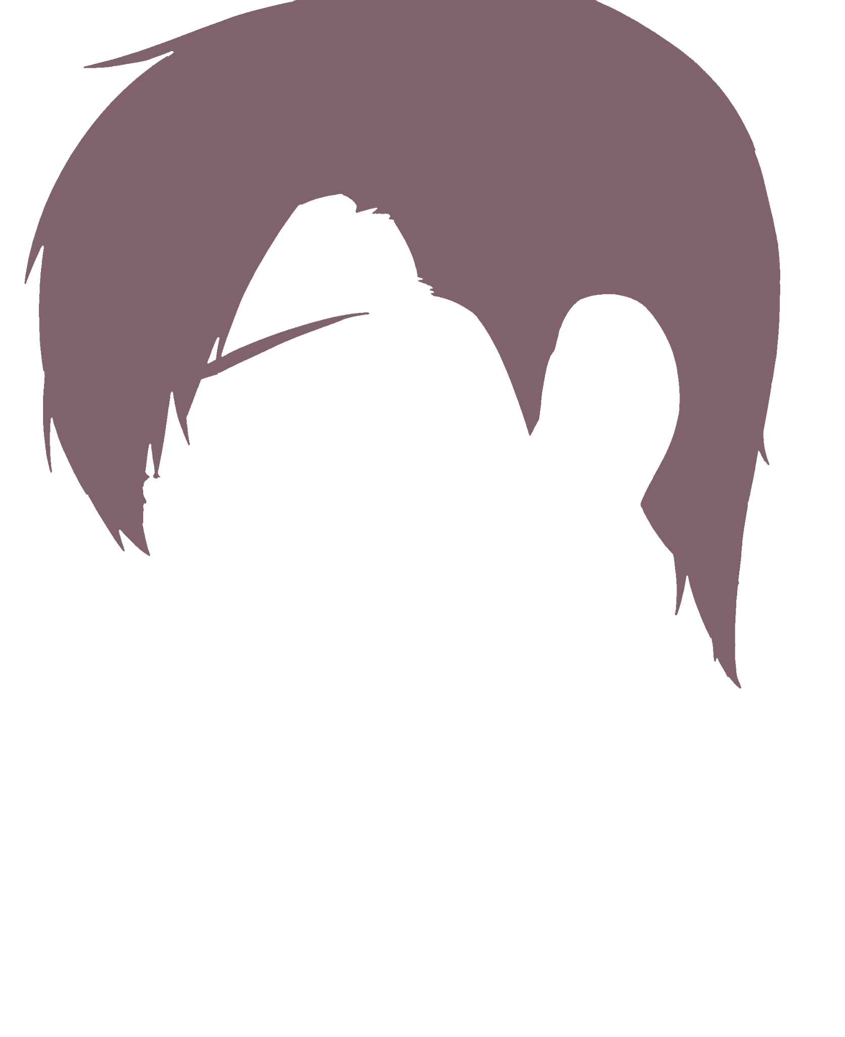
What is Flatting / Flat coloring?
Notes:
First of all, what is flatting?
Flatting is a colorization stage where the artists create a set of mutually exclusive layers, each of them represents “a semantically distinguishable area”.
There exists two industry requirements: consistency and completeness.

Slide 7
Flat Consistency
❌
✅
Notes:
Flat consistency means the desired color regions should consistently correct.
(click)
they always neither contain mergeable regions nor (click) spill out to their neighbor regions.
(click)
Therefore, professionals need to find and fix the (click) falsely closed and falsely opened lines before they bucket filling, and this task usually needs them to pay full attention.

Slide 8
Flat Completeness
Complete Segmentation
Notes:
The flat completeness requires all the flat layers should cover the whole drawing space (click) while mutually exclusive to each other.

Slide 9
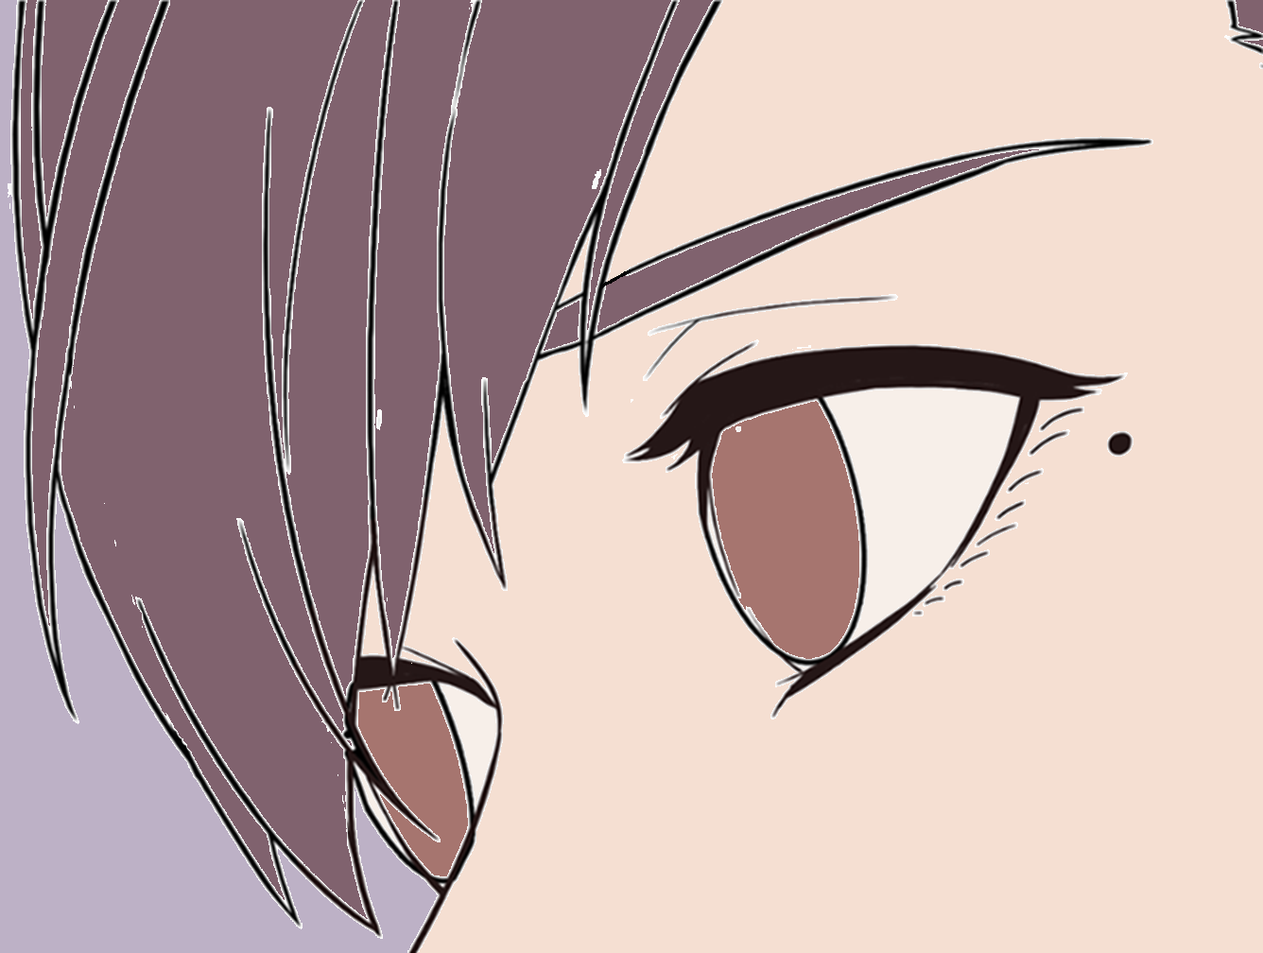
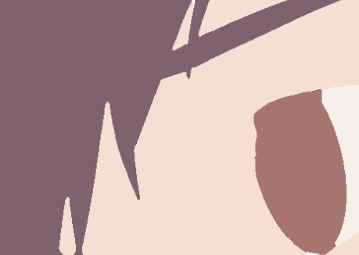
Flat Completeness
❌
✅
Notes:
Common failure cases in this requirement (click) are the “dirty bits” caused by anti-aliasing pixels and (click) the gaps under strokes when naively bucketing colors onto the line drawing. Fixing those problems is usually annoying.

Slide 10
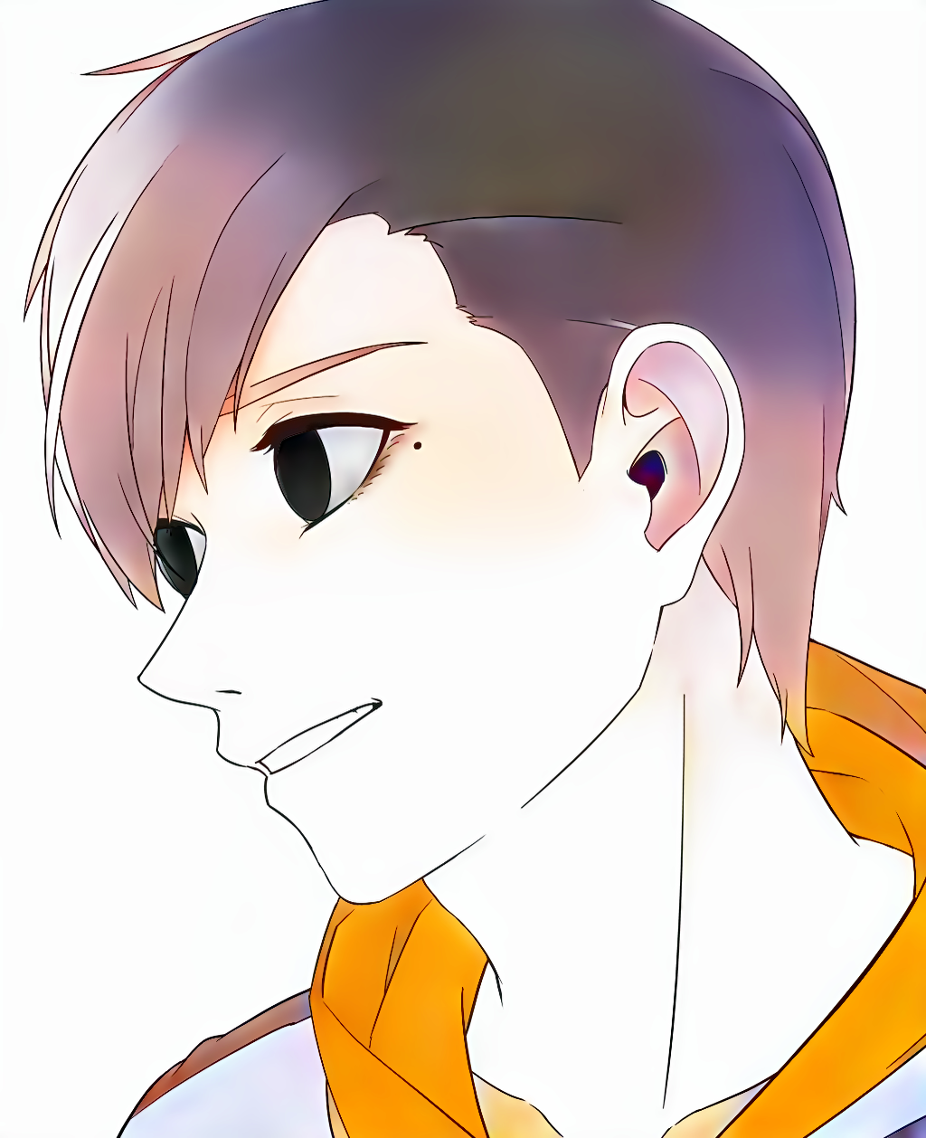
Why AI-driven Tools Don’t Help?
Colorization Instructions
❌
Adjustment
Style2Paint
[Zhang et al, 2018]
Notes:
participants also mentioned a common issue—lack of control—that makes it hard to adopt the tools in their workflow.
(click)
Although it is easy to get colorized results from AI tools, the professionals always need to make corrections or adjustments to those results, cause the AI usually can’t exactly match professional’s target.
(click)
However, it is difficult or even impossible to precisely feedback to AI tools, while directly fix on those outputs even need more effort than they colorize from scratch.

Slide 11
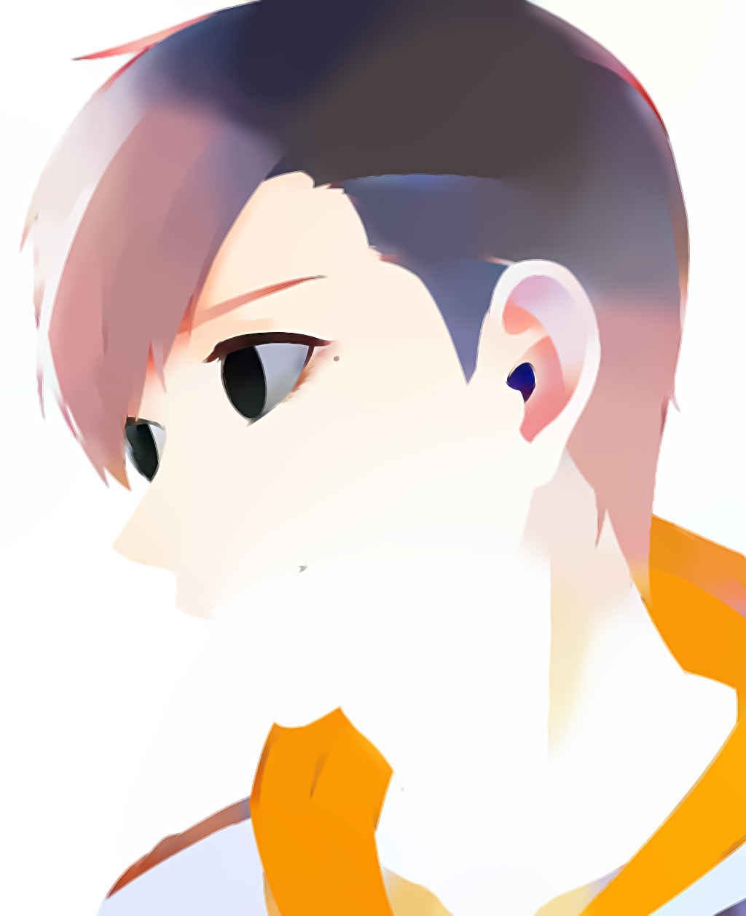
Why AI-driven Tools Don’t Help?
Colorization Instructions
…
❌
Adjustment
Style2Paint
[Zhang et al, 2018]
Notes:
On the tool design perspective, to find out the professional’s creatively mind is also difficult.
The ideal result will be highly personalized and therefore,
there always exists multi targets for each single input.

Slide 12
Formative Study (S1) - Conclusion
Notes:
To sum up, we found that:
different with colorization, flatting has only one “ground truth” for each line drawing

Slide 13
Formative Study (S1) - Conclusion
Costly
Manual
Flatting
Costly
Adjustment
Notes:
meanwhile it is also a bottleneck in the workflow since its costy workload when using general drawing softwares

Slide 14
Formative Study (S1) - Conclusion
Automate Flatting
FlatMagic
Adjustment
Notes:
So any speed up on this stage can help professionals invest more resources into later stages that matter more to the overall product quality.

Slide 15
Formative Study (S1) - Conclusion
Automate Flatting
Manual
Further
Colorize
FlatMagic
Adjustment
Manual
Adjustment
Style2Paint
[Zhang et al, 2018]
Notes:
therefore, they are more open to let automate tools deal with this less creative stage in order to release their creativity better

Slide 16
Formative Study (S1) - Conclusion
Automate Flatting
Manual
Colorize
…
FlatMagic
Adjustment
Manual
Adjustment
Style2Paint
[Zhang et al, 2018]
Notes:
To sum up, we found that:
different with colorization, flatting has only one “ground truth” for each line drawing
meanwhile it is also a bottleneck in the workflow since its costy workload
(click)
So any speed up on this stage can help professionals invest more resources into later stages that matter more to the overall product quality.
therefore, they are more open to let automate tools deal with this less creative stage
(click)
so that they can release their creativity more efficiently.

Slide 17
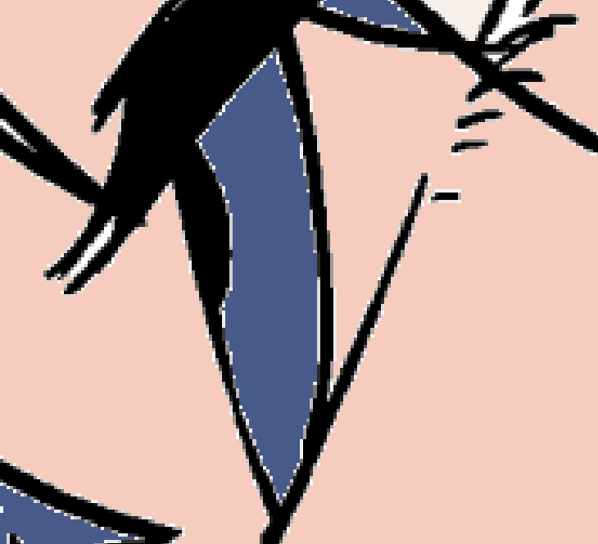
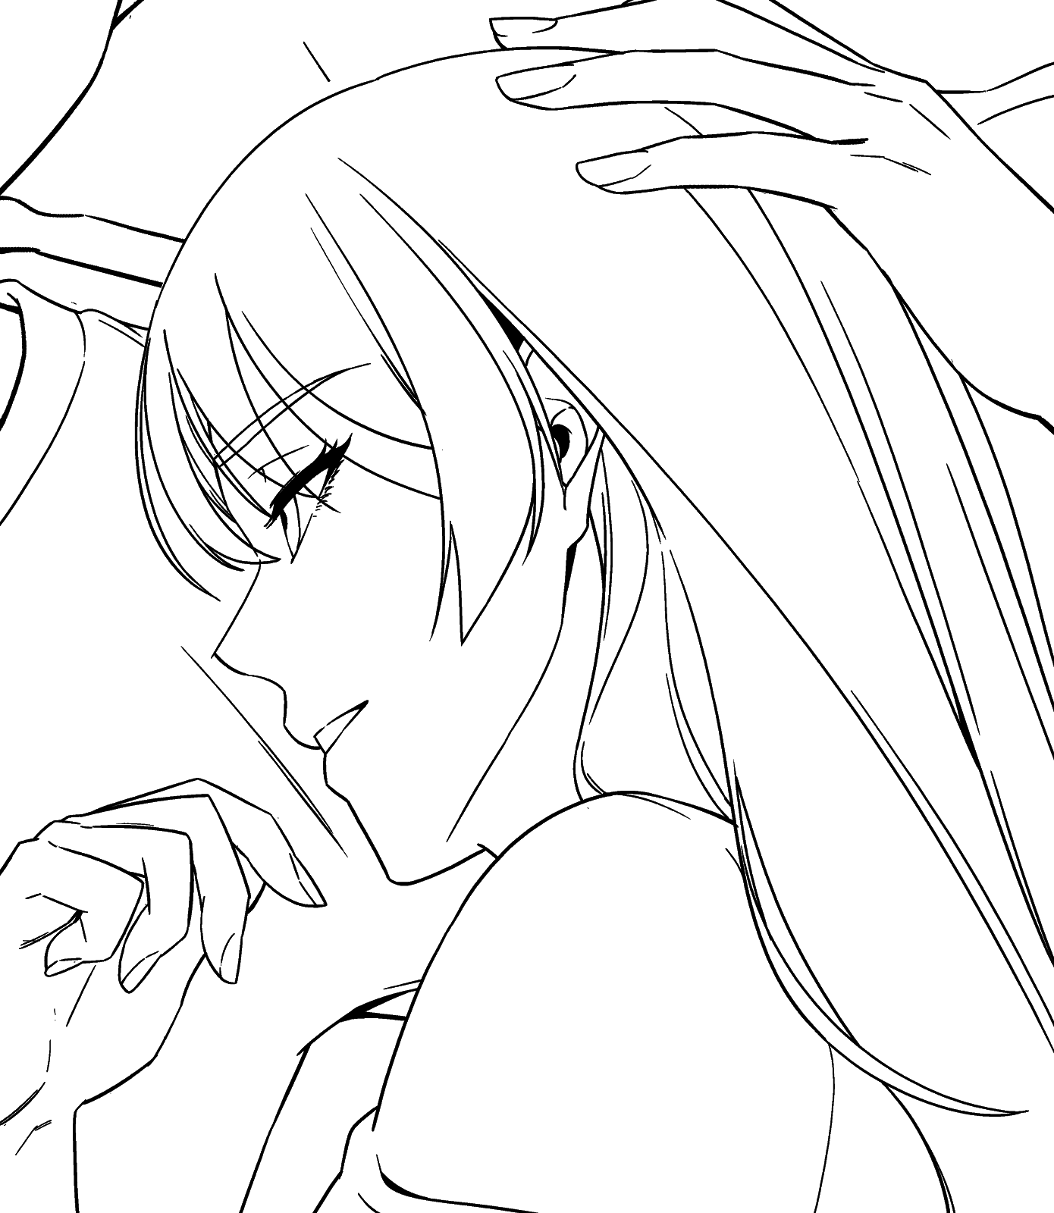
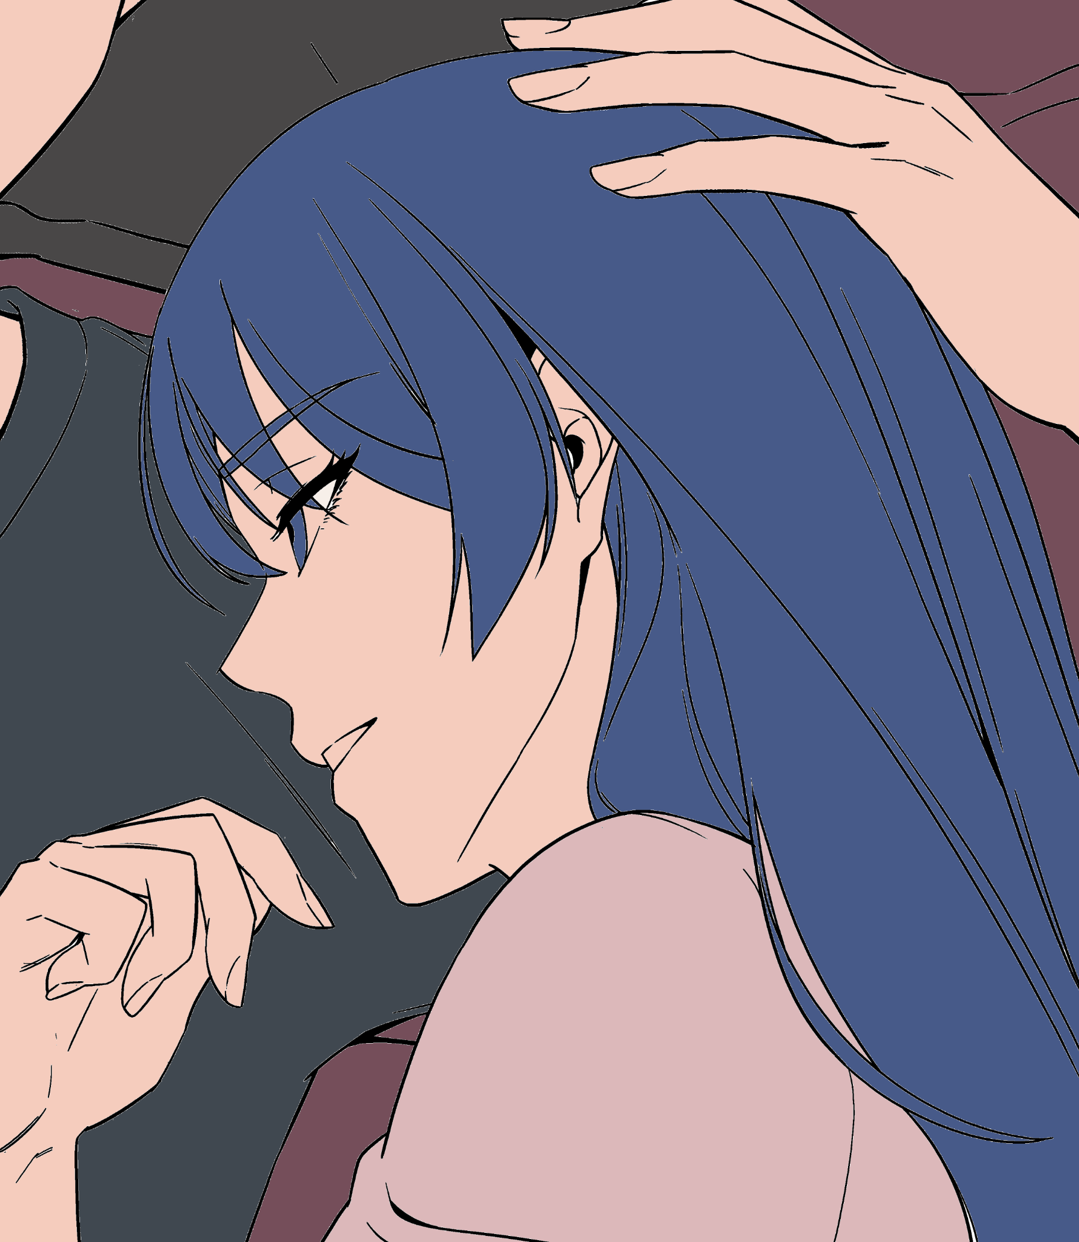
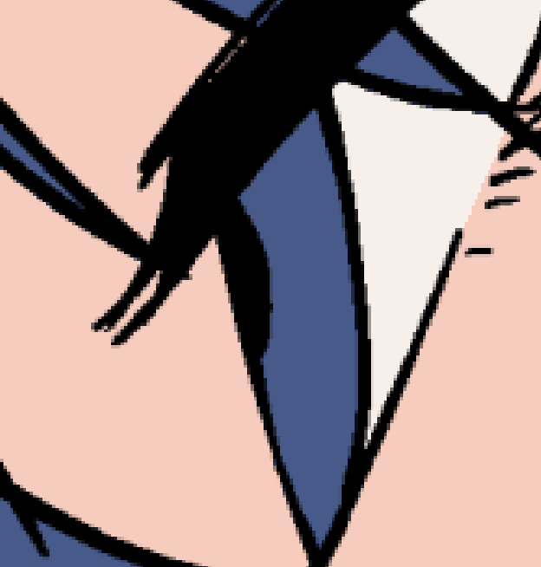
Flat Magic - Neural “re”drawing
Naive Bucketing
❌
✅
Input
Flatting Result
Notes:
So we designed the FlatMagic.
Given a input line drawing, how to design an efficient flatting method?
Remember professionals usually use bucket-filling even though it brings several artifacts such as wrong flat region and “dirty bits”.

Slide 18
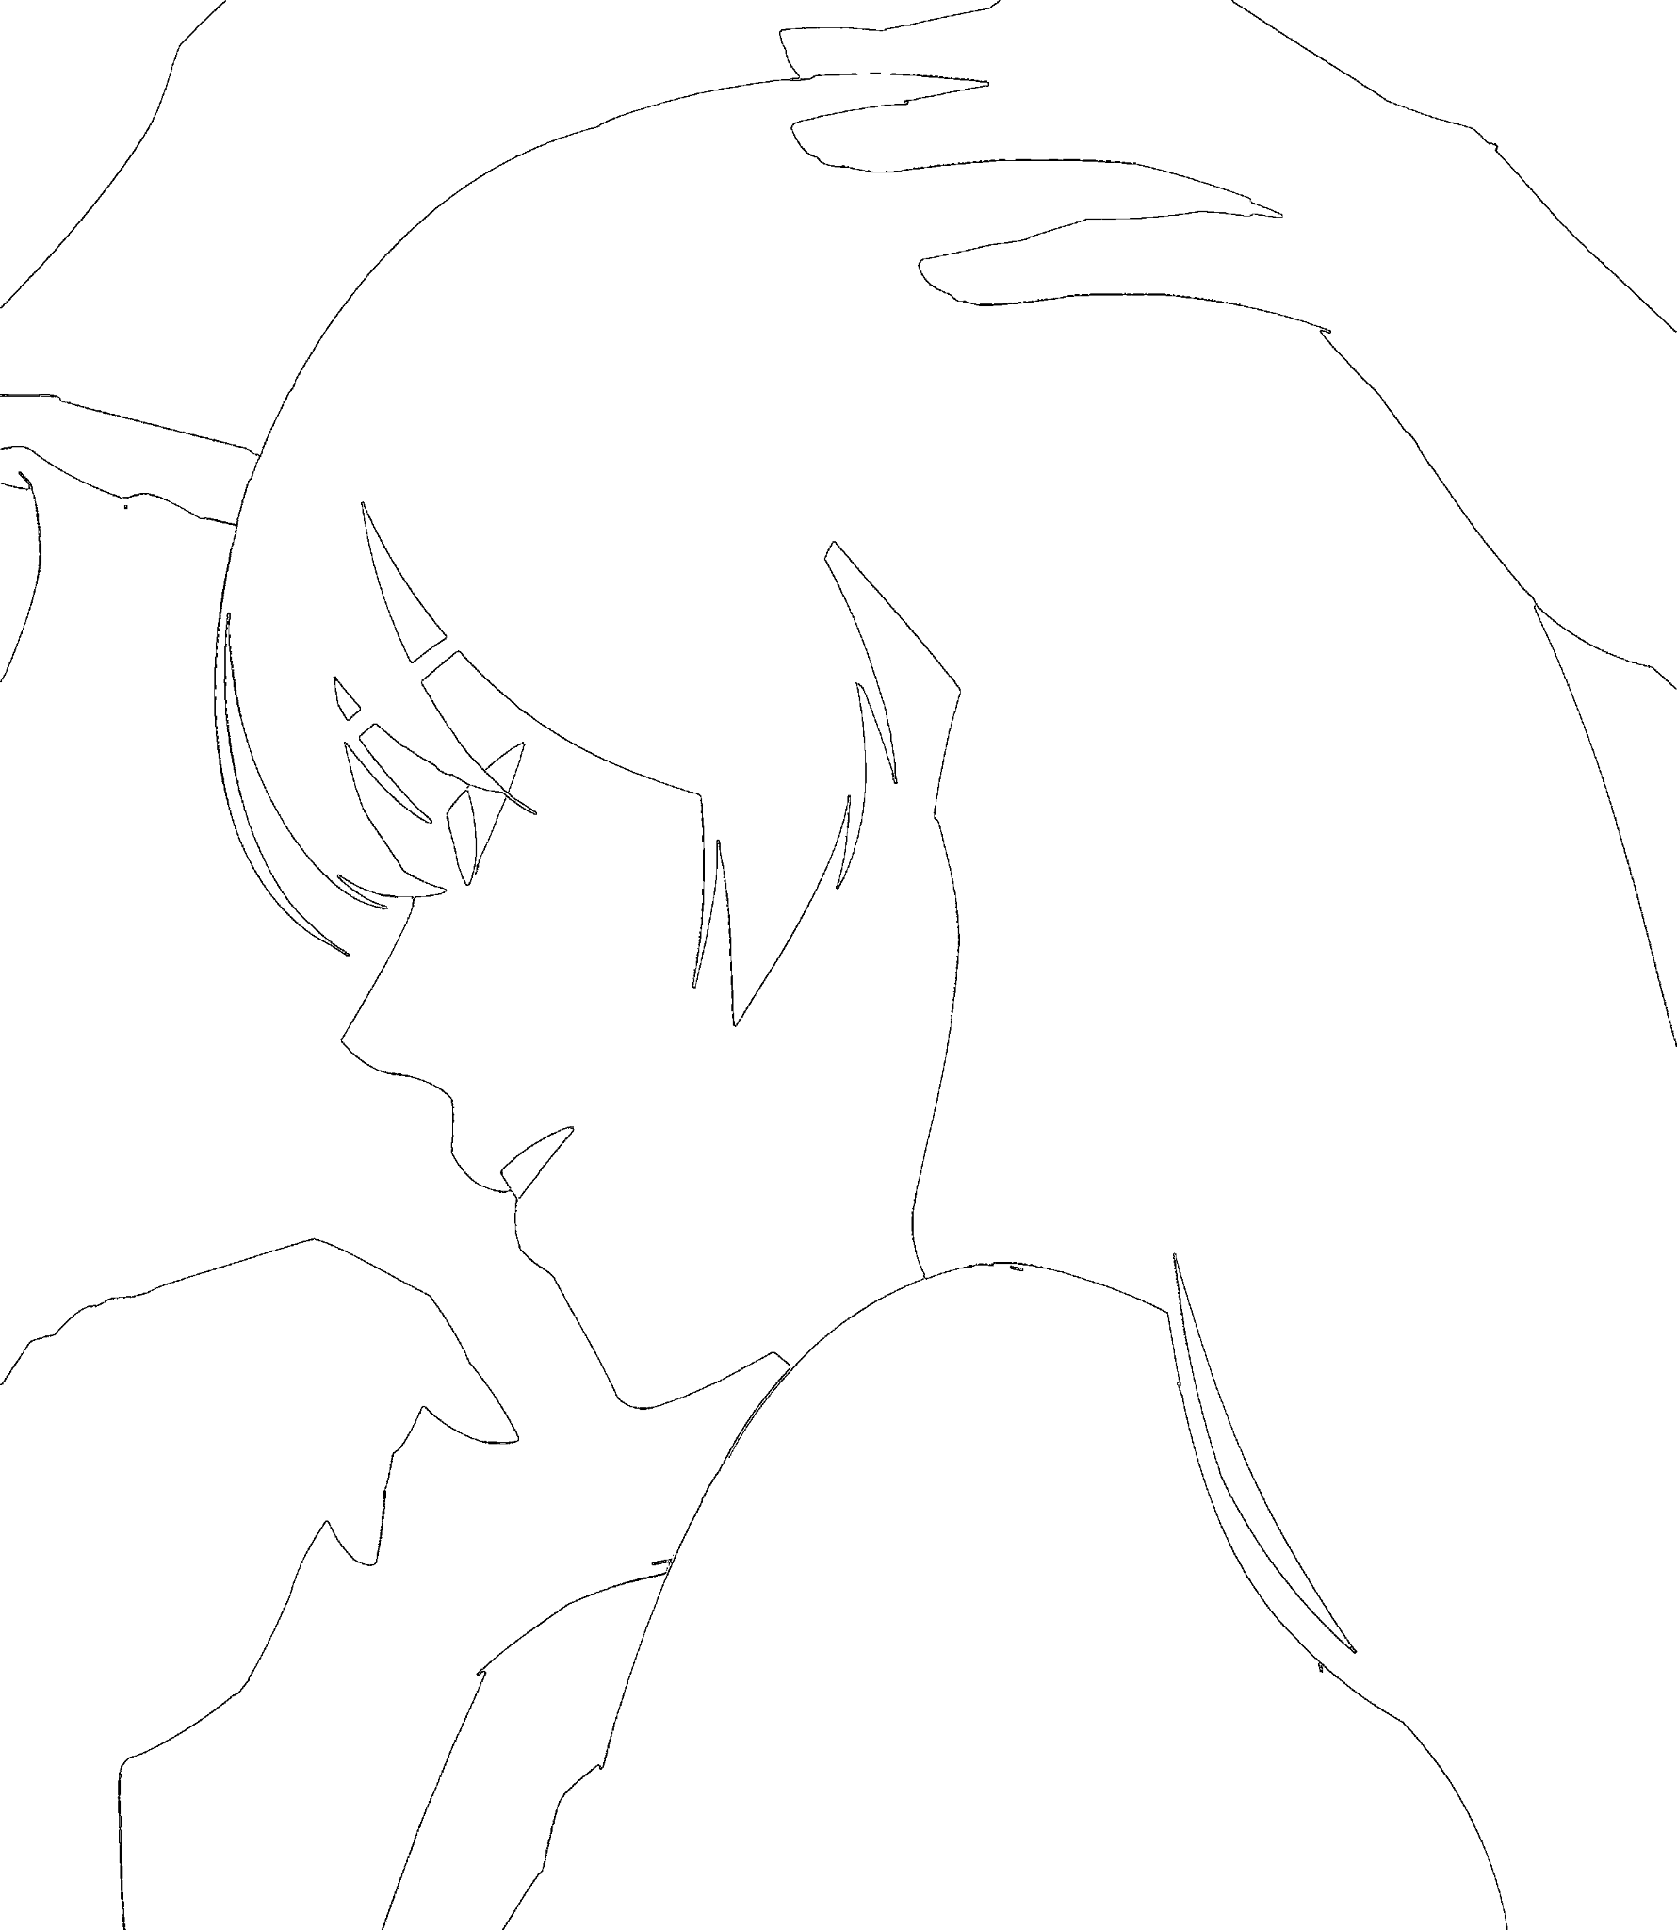
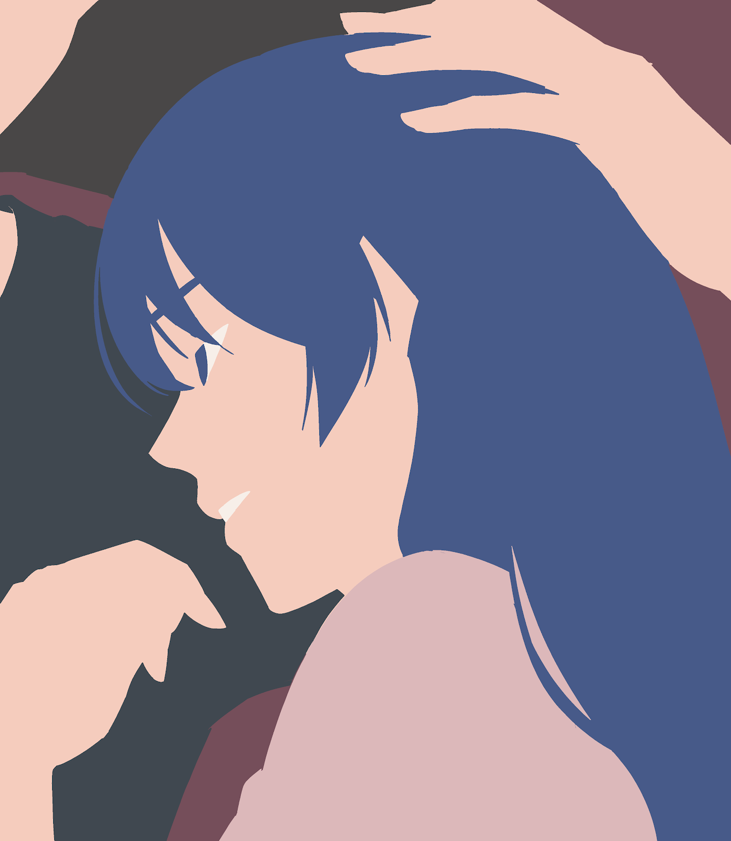
Flat Magic - Neural “re”drawing
Neural Redrawing
FlatMagic Bucketing
Simplified Line Drawing
Ideal
Flatting Result
Input
Notes:
Therefore, it is natural to build the interface of FlatMagic around this bucketing interaction.
Considering the fact that flatting is color agnostic. To let user bucket freely and get a most correct result,
(click)
we built a neural network to simplify the input lines.
The target of the simplification is 1-pixel width boundary extracted from the idea flatting result,
We called this procedure as neural re-drawing.
(click)
Then we let user to bucket filling on this simplified line drawing.

Slide 19
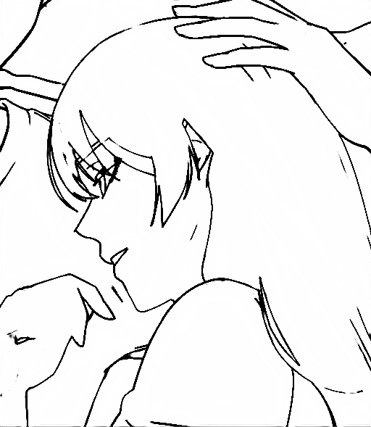
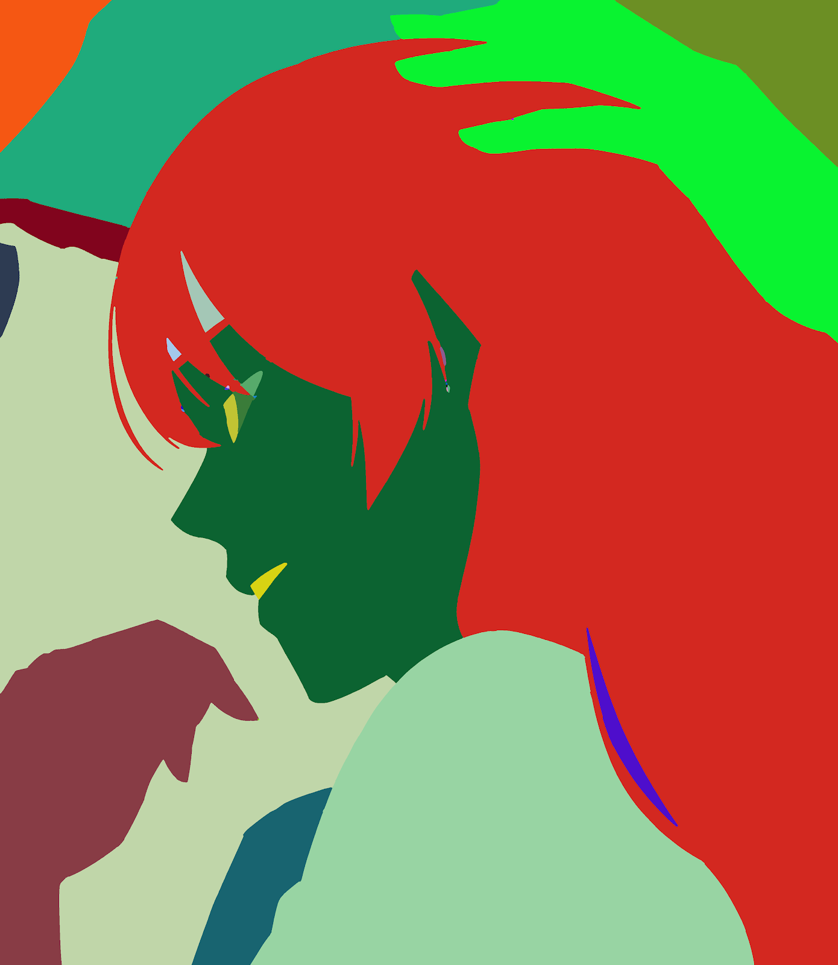
Flat Magic - Automate Initial Flatting
Input
Neural redrawing
Trapped ball Filling
Post processing
Notes:
The neural re-drawing model is trained based on the ground truth dataset which shared with us by a digital comic company.
(click)
Then we use the trapped ball filling algorithm to label the simplified lines,
(click)
and post process it to initial flatting result by our proposed color bleeding removal algorithm.
For more implementation details, please check our paper.

Slide 20
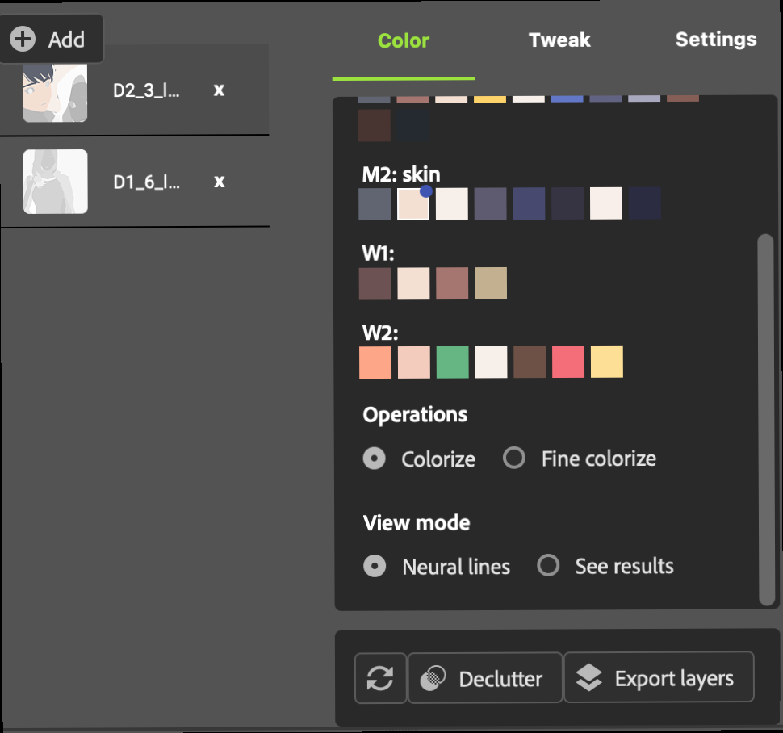
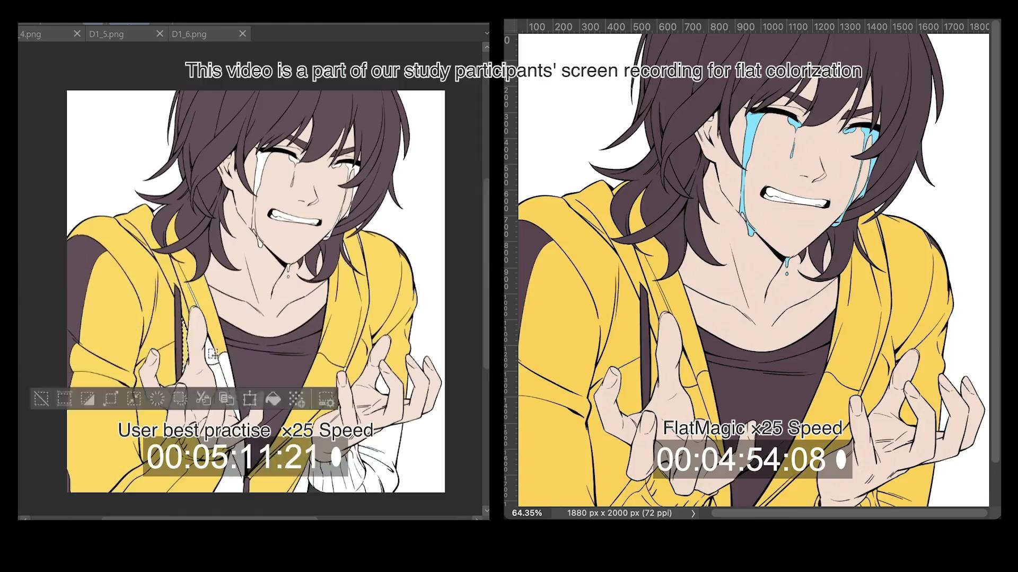
Flat Magic - User Interface
Notes:
The user interface is implemented as an Adobe Photoshop plugin, it receives the result from the neural redrawing model
, and allow users to manually colorize it to the desired professional level result by our improved bucketing tool.
For more UI details, please check out our paper.

Slide 21
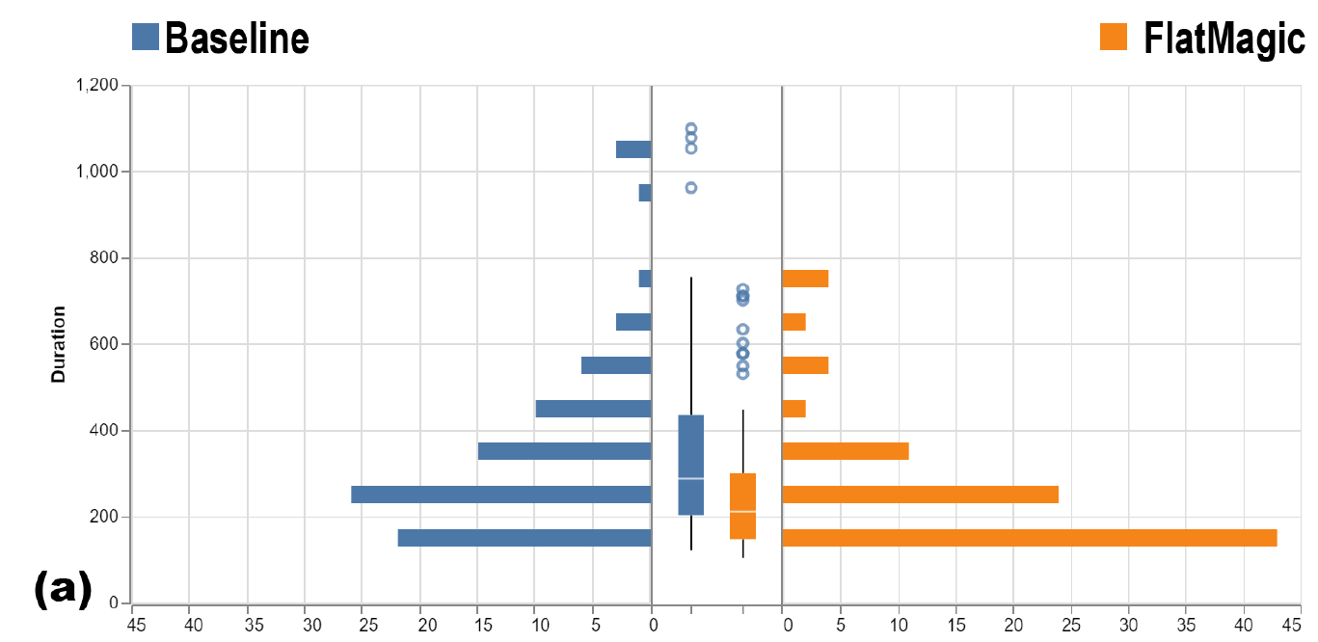
Experimental Study - Flatting Time
More people close to the bottom (used less time) is better
better
better
better
Notes:
To verify the efficiency of our FlatMagic.
We recruited 16 students who are majoring digital comic and animation, then asked them to flat 12 line drawings by their best practice as the baseline and by FlatMagic, respectively.
The flat time distribution result shows using FlatMagic helped participants to significantly reduce their labor.

Slide 22
Experimental Study - Flatting Quality
More pass result is better
better
Notes:
And the outcomes quality measurement shows participants could achieving similar or even slightly better outcomes to the professional’s best practice by using our FlatMagic.
For more experiment data and analysis, please check our paper.

Slide 23
Intermediate Representation
Easy and Cheap
AI Over-Scoping
Difficult and Costly
Notes:
So, here are some interesting high level insights on our finding which we called it intermediate representations.
Most of the AI’s automation methods provide a full automation with no revisable check points,
while most professionals did not like this, which we call it AI over-scoping.

Slide 24
Intermediate Representation
Easy and Cheap
AI Over-Scoping
Difficult and Costly
Intermediate Representation
Easy and Cheap
Notes:
In contrast, intermediate representations offer a modularized architecture and representation so that makes it possible for users to know where and how to make necessary corrections.

Slide 25
Intermediate Representation
#1. Understand a detailed, stage-by-stage workflow
Notes:
Though identifying good intermediate representations and modularization are not always feasible, we reflect on some possible decision points when considering the design of AI systems.
First of all, we need to understand the detailed, stage by stage workflow of professional’s task.

Slide 26
Intermediate Representation
#2. Then consider the AI usefulness and the User intention
for a given AI tool
Notes:
Then carefully evaluate the degree of AI usefulness and User intention at each stage in the workflow.
AI usefulness reflects how much work labor AI could cut down for the user.
User intention means how much a user desires to let a particular step automated

Slide 27
AI/intention quadrant
Useful AI
The most promising tool.
Likely to be adopted.
S1
S2
Positive Intention
Negative Intention
S3
S4
Not Useful AI
Notes:
When consider AI-usefulness and user intention as two different dimensions.
We can project all the AI automation methods on to the strategic space for considering how and if this tool may be adopted.
The most promising case would be S1, where the AI is useful and its valuation is positive.

Slide 28
AI/intention quadrant
Useful AI
The most promising tool.
Likely to be adopted.
Find a better strategy to convince a user to adopt.
S1
S2
Positive Intention
Negative Intention
S3
S4
Not Useful AI
Notes:
In S2, when the AI is useful, we may still have a situation where an individual either doesn’t want or doesn’t think they want, the automation.
This suggests us that it is worth considering a better adoption strategies to convince a user to adopt.

Slide 29
AI/intention quadrant
Useful AI
The most promising tool.
Likely to be adopted.
Find a better strategy to convince a user to adopt.
S1
S2
Positive Intention
Negative Intention
S3
S4
Find a more reasonable automation scope for AIs first.
Not Useful AI
Notes:
In S3, When the end-user may want something automated, but the AI is unable to meet the objective.
Introducing a problematic AI will discourage adopting the current AI tool or even all other similar tools.
This suggest us maybe finding a smaller intermediate representation to design a more reasonable AI-automation scoping is needed.

Slide 30
AI/intention quadrant
Useful AI
The most promising tool.
Likely to be adopted.
Find a better strategy to convince a user to adopt.
S1
S2
Positive Intention
Negative Intention
S3
S4
Find a more reasonable automation scope for AIs first.
“Back to the drawing board.”
Not Useful AI
Notes:
In S4, while this worst case may be a “back to the drawing board” situation,
However, it may also could be the result of didn't correctly model the needs, didn't build the right UI or did not implement the algorithm well.

Slide 31
Intermediate Representation
#3. Be careful of merging the automation scope when building the tool.
Notes:
At last, after we decide the right AI-automation scoping
we need to be careful of merging the AI driven automation scope when build up the tool.
Cause merging multiple steps can ‘break’ a user’s mental model of the process.
The user may not be able to identify how or why errors are occurring or how to correct for them.
Thus, the second key consideration is if there is an advantage or need to interact with intermediate artifacts.
In many situations, professionals can correct for errors by accessing to those intermediate states. Eliminating that ability is detrimental.

Slide 32
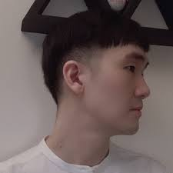
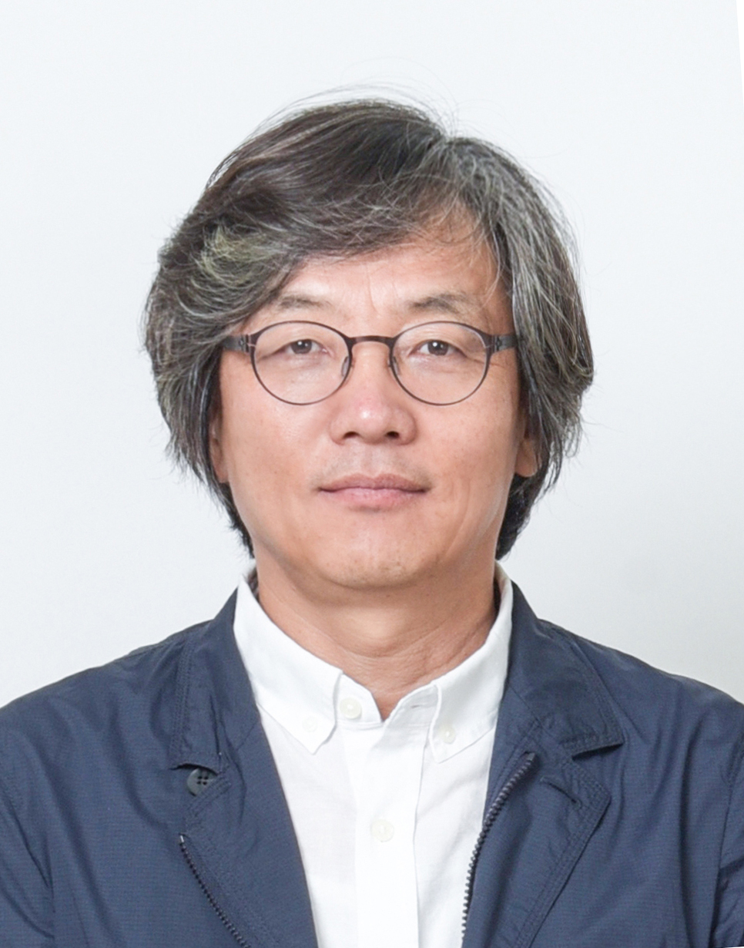
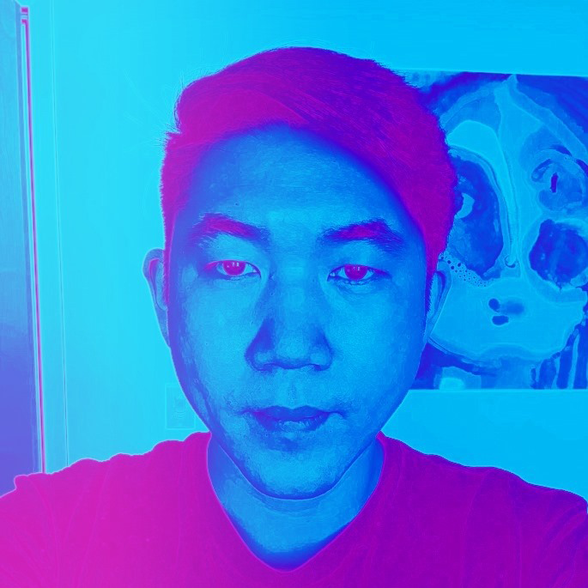
Collaborators
John Joon Young Chung
Kiheon Yoon
Yotam Gingold
Eytan Adar
Sungsoo Ray Hong
cyan3@gmu.edu
Thanks for listening
Notes:
At last I want to thank all my collaborators and Thank you for listening.
Feel free to reach me out if you have questions

Slide 33
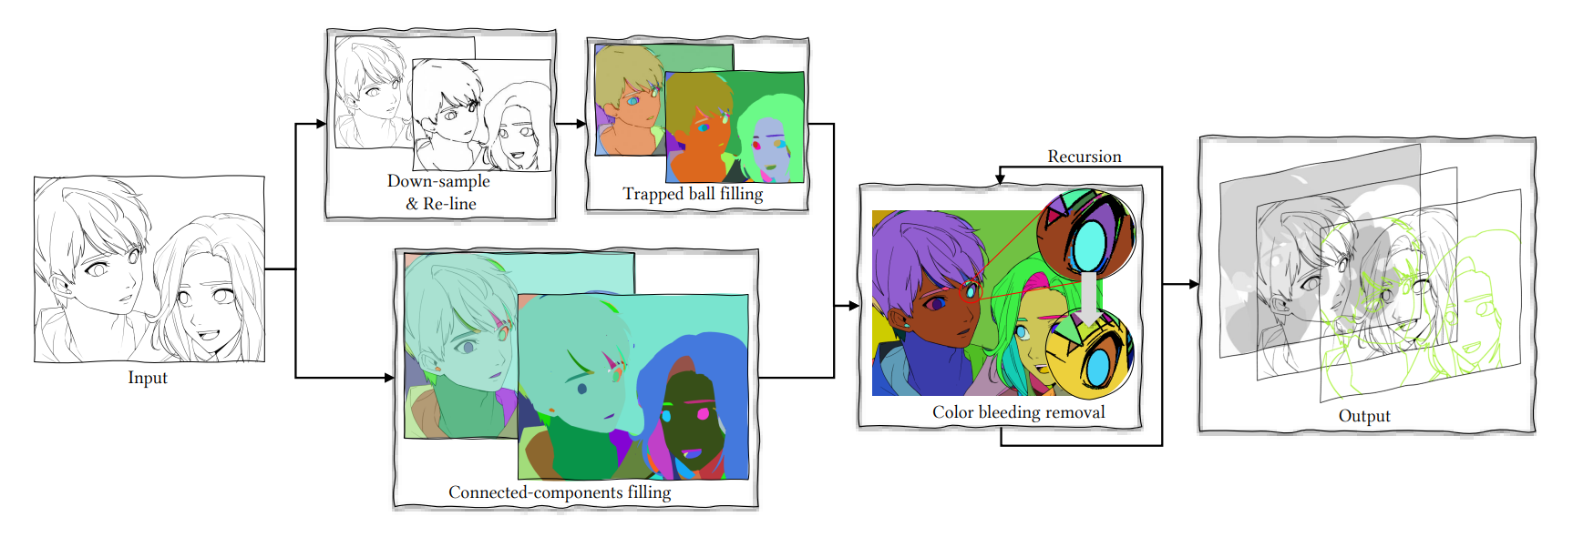
Flat Magic - Automate Initial Flatting

Slide 34
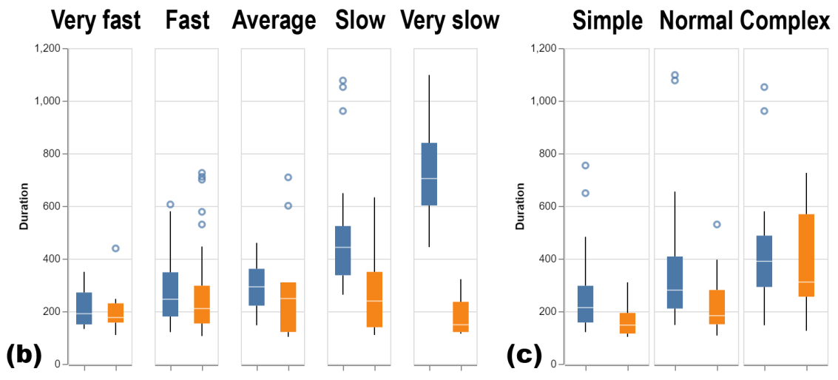
Experimental Study - Flatting Time Improvment
People Groups with different skills
Line Drawing Groups with different complexities

Slide 35
Experimental Study - User Feedback

Slide 36
Future Work
Stage-Focused Design
More accurate initial Flatting result
Interactive Shadowing
Inter-color harmony
Working on Multiple Panels
Semantic-based batch flat
Headless and batch processing
Notes:
[too long, this may be need to be skipped]
There is still a lot of space for improvement based on the interviews in our user study.
For example, we can further improve the accuracy of the neural reline model which could cutdown more bucketing time.
Some users indicated that they wished they could specify light sources and draw rough guidelines to create fast cel-style shadows
or the tool can suggest or manage a global flatting color palette automatically.
We can even go a step further, for example we can flat one character in one panel and propagate this flatting result to the rest panels which contain the same character.
Or ultimately, this could be entirely automated without the use of the GUI. The tool could output results that be used directly in the next stage if we can understand the input image well.

Slide 37
Possible Questions
How long did the FlatMagic to process one image?
Why the gap under the lines in native bucket-fill result matters?
More details of the backend?
How did user feedback on using FlatMagic?

